Slide 1
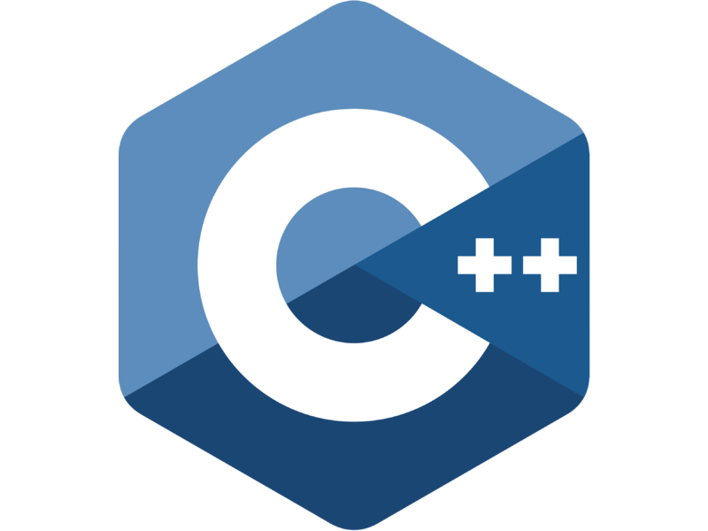

Decision control statement
Kusal Bista

Slide 2
C++ decision making statements
Decision making structures require that the programmer specify one or more conditions to be evaluated or tested by the program, along with a statement or statements to be executed if the condition is determined to be true, and optionally, other statements to be executed if the condition is determined to be false.

Slide 3
Types of C++ decision making statement
if statement
if...else statement
switch statement
nested if statements

Slide 4
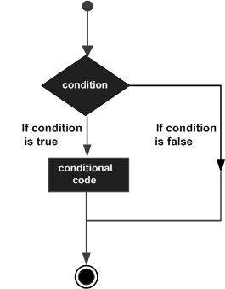
C++ decision making statements

Slide 5
C++ if statement
The syntax of an if statement in C++ is −
if(boolean_expression)
{
// statement(s) will execute if the boolean expression is true
}
If the boolean expression evaluates to true, then the block of code inside the if statement will be executed. If boolean expression evaluates to false, then the first set of code after the end of the if statement (after the closing curly brace) will be executed.

Slide 6
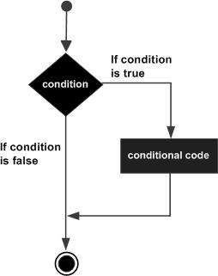
C++ if statement- Flowchart

Slide 7
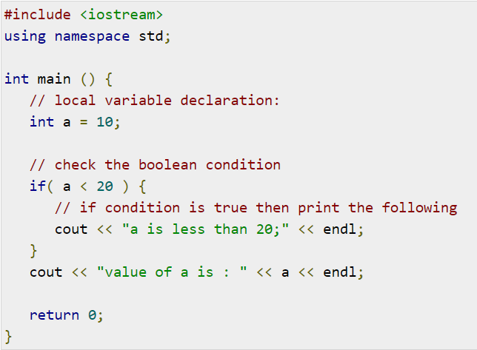
C++ if statement - example

Slide 8
C++ if...else statement
If the boolean expression evaluates to true, then the if block of code will be executed, otherwise else block of code will be executed.
if(boolean_expression)
{
// statement(s) will execute if the boolean expression is true
}
else { // statement(s) will execute if the boolean expression is false
}

Slide 9
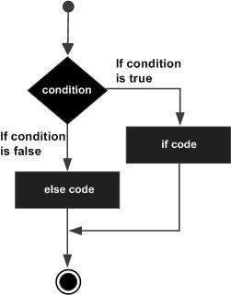
C++ if...else statement - Flowchart

Slide 10
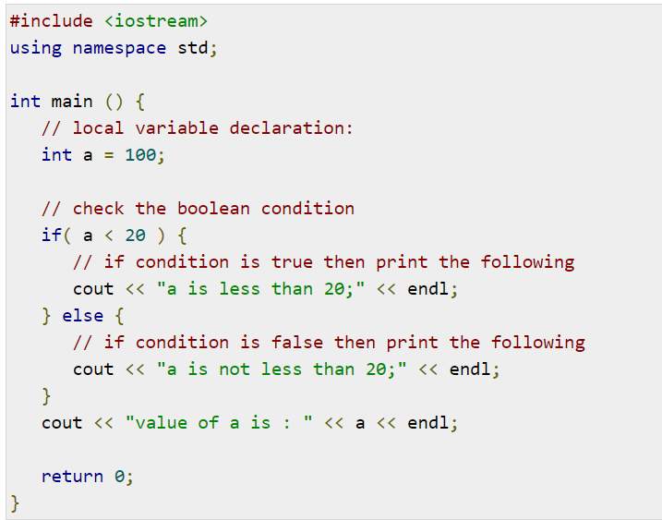
C++ if...else statement - Flowchart

Slide 11
if...else if...else Statement
An if statement can be followed by an optional else if...else statement, which is very useful to test various conditions using single if...else if statement.
When using if , else if , else statements there are few points to keep in mind.
An if can have zero or one else's and it must come after any else if's.
An if can have zero to many else if's and they must come before the else.
Once an else if succeeds, none of the remaining else if's or else's will be tested.

Slide 12
if...else if...else Statement
if(boolean_expression 1)
{ // Executes when the boolean expression 1 is true
} else if( boolean_expression 2)
{ // Executes when the boolean expression 2 is true
} else if( boolean_expression 3) {
// Executes when the boolean expression 3 is true }
else { // executes when the none of the above condition is true.
}

Slide 13
C++ switch statement
A switch statement allows a variable to be tested for equality against a list of values. Each value is called a case, and the variable being switched on is checked for each case.

Slide 14
C++ switch statement-Syntax
switch(expression)
{
case constant-expression :
statement(s);
break; //optional
case constant-expression :
statement(s);
break; //optional // you can have any number of case statements.
default :
//Optional statement(s);
}

Slide 15
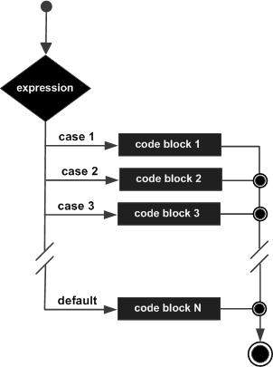
C++ switch statement- Flowchart

Slide 16
C++ nested if statements
It is always legal to nest if-else statements, which means you can use one if or else if statement inside another if or else if statement(s).

Slide 17
C++ nested if statements
if( boolean_expression 1)
{
// Executes when the boolean expression 1 is true
if(boolean_expression 2)
{
// Executes when the boolean expression 2 is true
}
}

